Slide 1

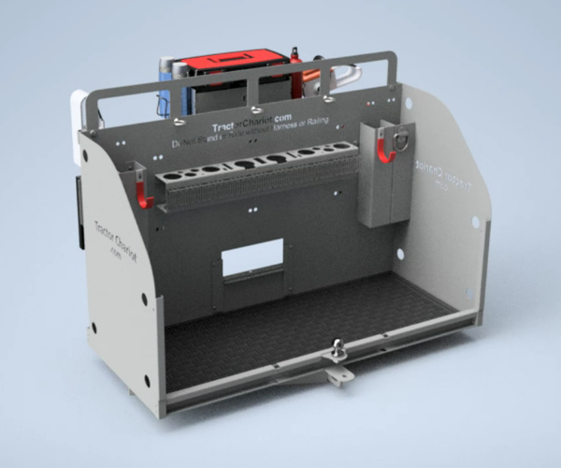
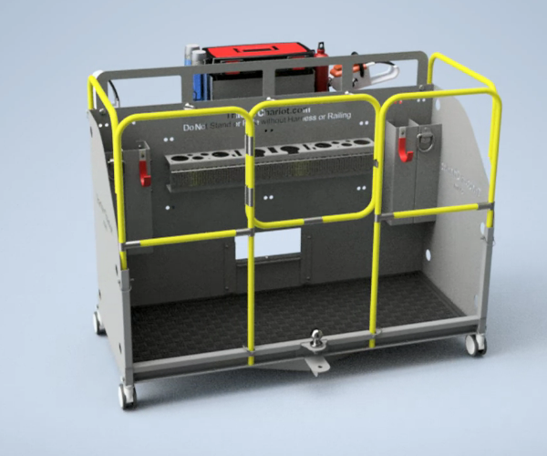
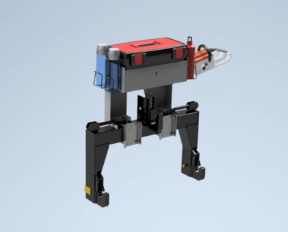

The Tractor Chariot is an Innovative and Indispensable Tractor Implement
This professional grade, multi-purpose Implement, easily attaches to any Tractor
The Chariot efficiently performs many maintenance, landscaping and wood cutting tasks
Start
Tractor Chariot
Tractor Chariot CAD
Confidential - Not for Distribution
Property of EDA, LLC - Version 1.4
Quick Hitch - Tool Rack
Tractor Chariot Costing
Tractor Chariot - Tool Frame
Tractor Chariot Trademarks
Electronic Design Associates, LLC
Jim@DesignTeam.com
Innovative Real World Design

Slide 2
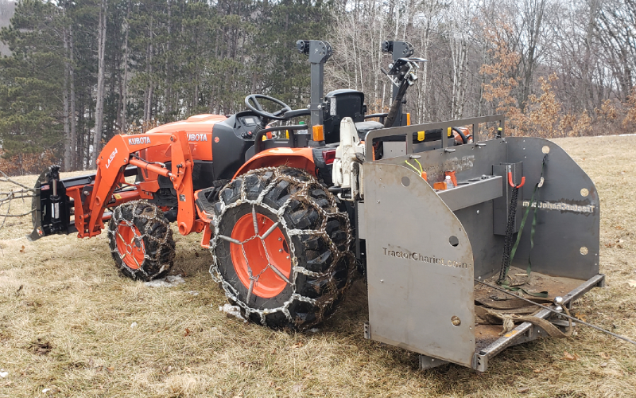
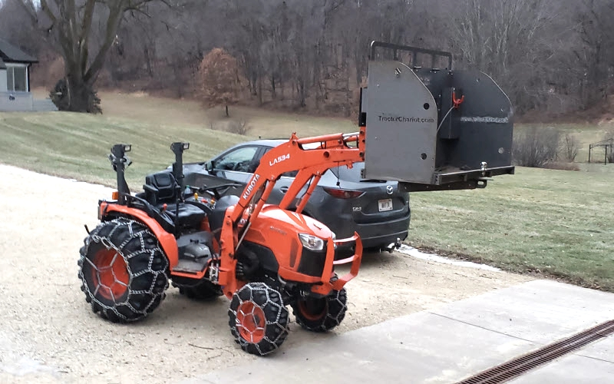
Every Tractor needs a Chariot
Chariot on Tractor
Chariot Work Platform
Tractor Chariot

Slide 3
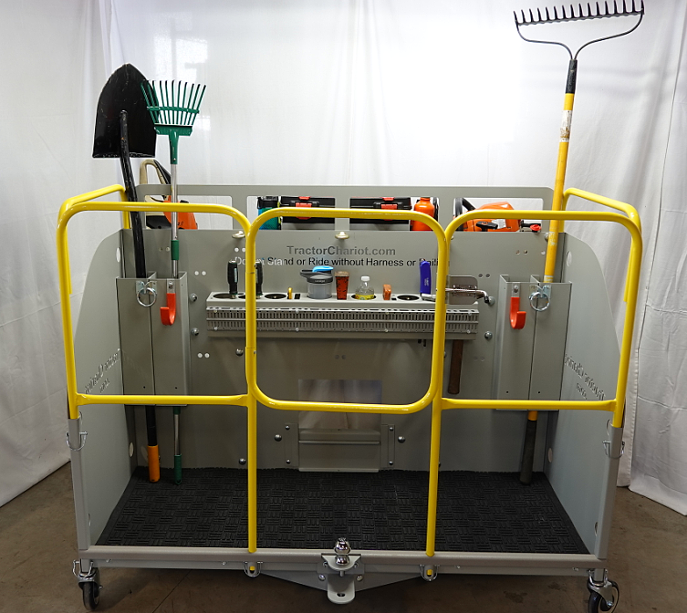
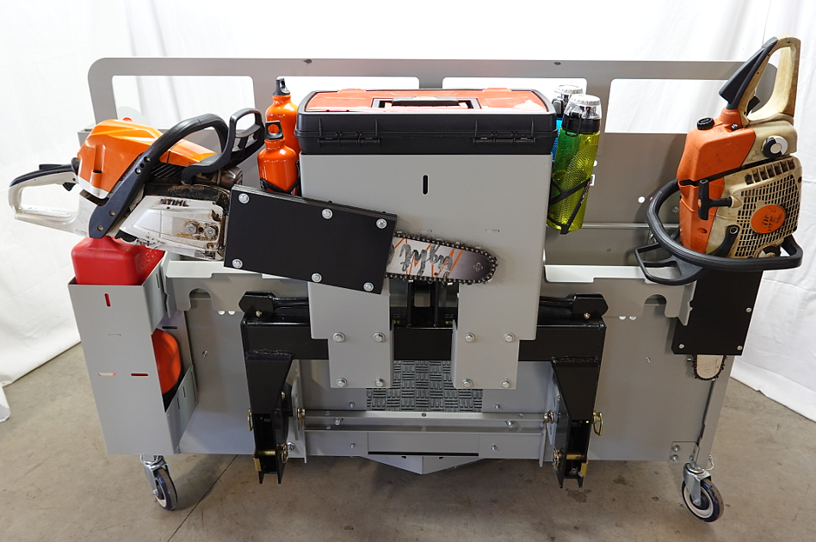
Super Charge your Tractor
Tractor Chariot Front
Tractor Chariot Rear
Tractor Chariot

Slide 4

Tractor Chariot
Click to Play Animation
Tractor Chariot with Safety Railing
Click to Play Animation
Quick Hitch - Tool Rack
Click to Play Animation
Tractor Chariot
Play
Tractor Chariot without Quick Hitch – Tool Rack

Slide 5

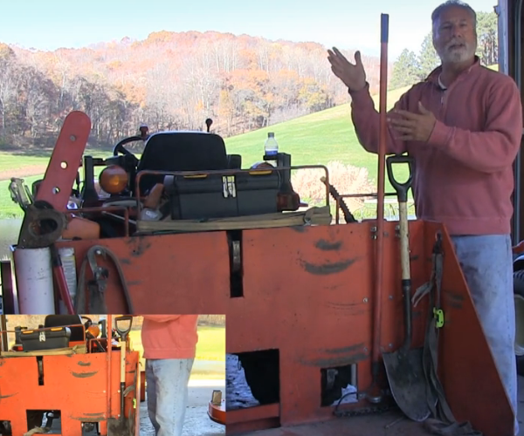
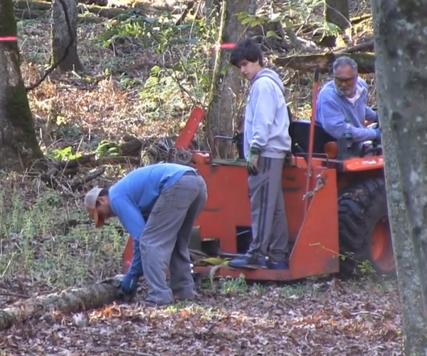
Tractor Chariot Features
Click to Play
Tractor Chariot at Work
Click to Play
Turn your volume up
Tractor Chariot

Slide 6

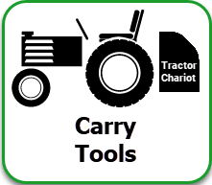
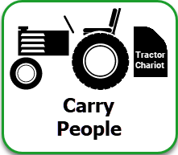
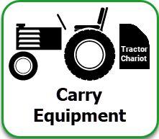

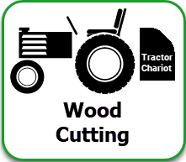
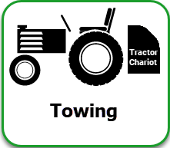

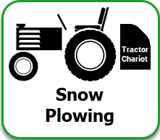
“The Essential Tractor Implement“
“Much more than a Carry All”
Tractor Chariot
View
Tractor Chariot Pictures

Slide 7

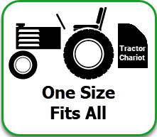
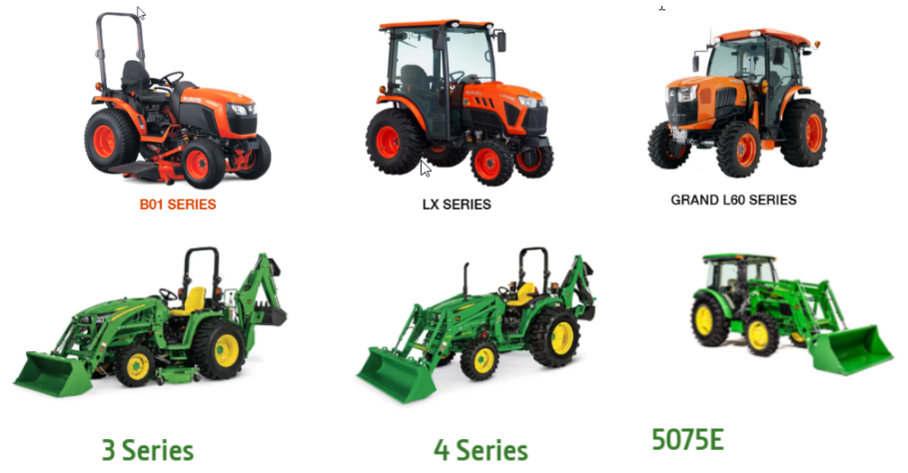

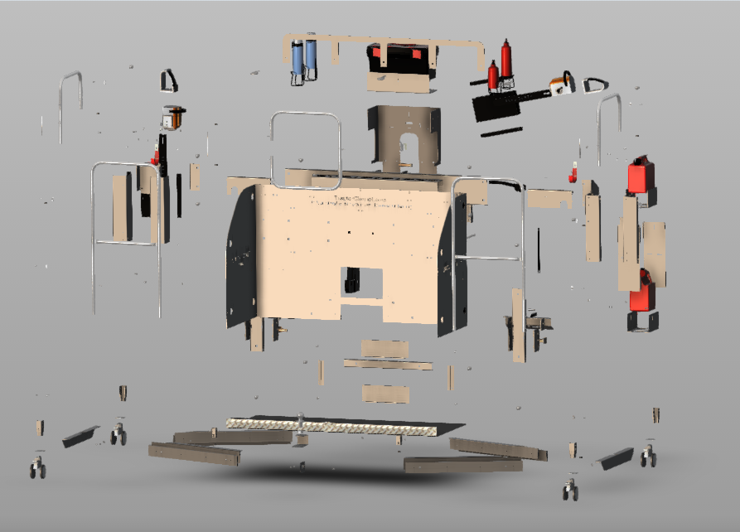
The Tractor Chariot fits all compact and commercial Category 1 and 2 Tractors
The Tractor Chariot is easily attached and removed from your tractor with two simple levers
Dimensions: L “60" x H "48" x D "27" Weight 275 lbs
Quick Hitch Tool Rack (w/o Quick Hitch): 25 lbs
Innovative Real-World Design and Build to Last
Sturdy steel construction with a rigid 3 Point mounting frame
Bolt on Accessories to suit your specific needs
Tractor Chariot

Slide 8
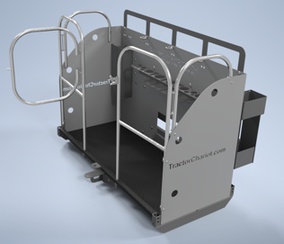

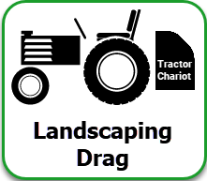
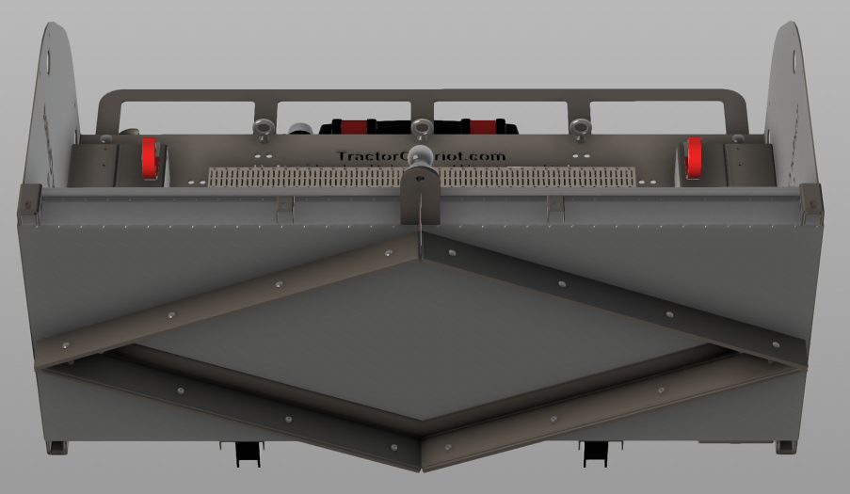
Long Lasting Rust Free
Durable Hammer-Tone Powder Coated Finish
Powder Coated in Gray, Kubota Orange and John Deere Green
The Tractor Chariot diamond shaped Drag easily landscapes dirt, sand, gravel and plows snow
A strong diamond shaped landscaping blade, with replaceable wear bars, grades in both forward and backwards directions
Side Panels are easily attached with 2 pins, to keep gravel and dirt from exiting either one or both sides of the Chariot
Tractor Chariot

Slide 9
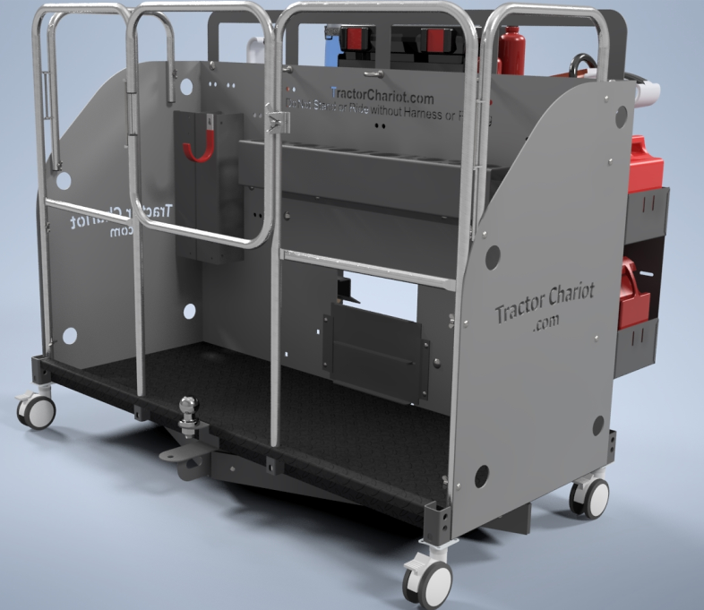
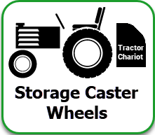
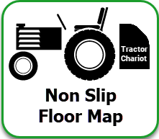
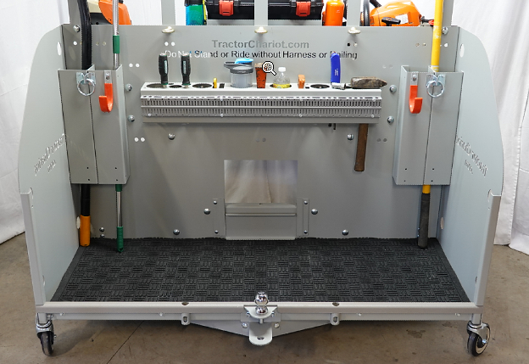
Caster Wheels are easily removed with 4 pins, enabling you to roll the Chariot around for easy storage
The Safety Railing is easily removed with 6 pins and folds flat for storage
Floor Mat adds comfort and safety
Non-Slip Rubber Floor Mat covers the entire
base of the Chariot, and can be removed for cleaning
Tractor Chariot

Slide 10
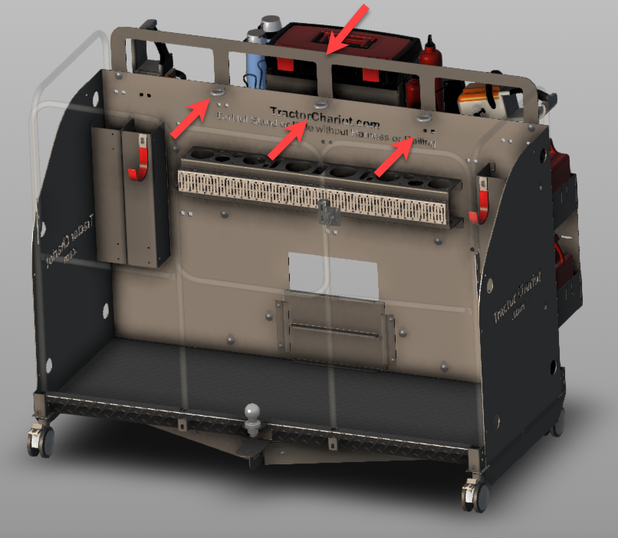


A sturdy Grab Handle makes it easy to maintain your balance when riding in the Chariot
Steel Eye Hooks enable you to attach up to 3 Body Harnesses
Tractor Chariot features a Safety Railing that is easily removed with 6 pins and folds flat for storage
The Safety Railing Door opens into the Chariot and will not accidentally open
Safety Caution message is Laser Cut into Chariot body
"Only Ride in Chariot with Safety Railing or Safety Harness"
Tractor Chariot

Slide 11

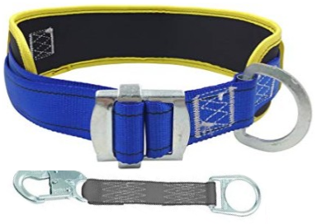
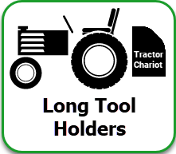
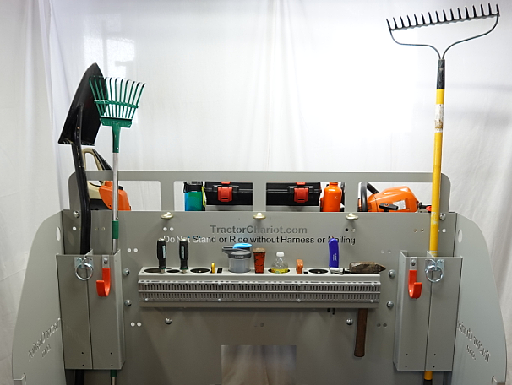
Steel Eye Hooks enable you to attach up to 3 Body Harnesses
These Hooks can also be used to secure equipment with Gear Ties or Tie Down Straps
4 Tool Tubes are used to carry shovels, rakes, tree trimmers, pruning shears and other long handle tools
Hooks and Hitch Rings mounted on the Tool Tubes to hang tow cables, hoses, electrical cables, and other items
Tractor Chariot

Slide 12
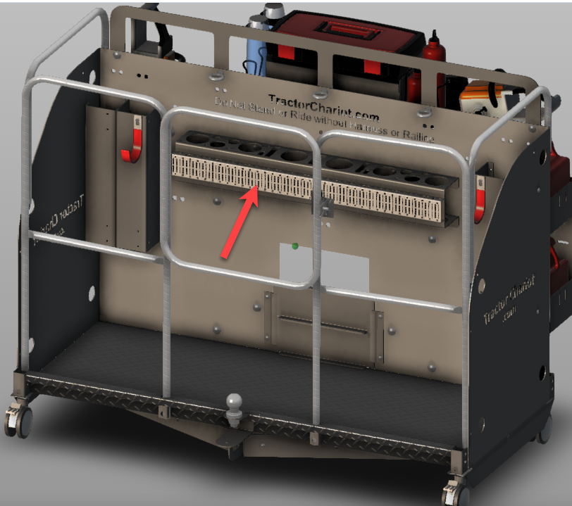

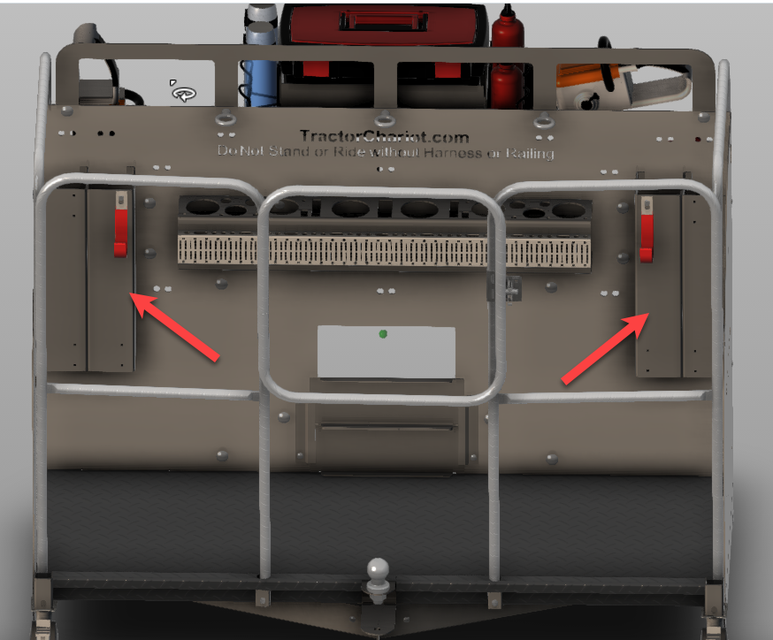

The Tap Mount Rail on the Tool Rack and has many accessories for hanging tools and storage containers
Hooks and Hitch Rings mounted on the Tool Tubes carry tow straps, tow cables, electrical cables, and other items
Tractor Chariot

Slide 13
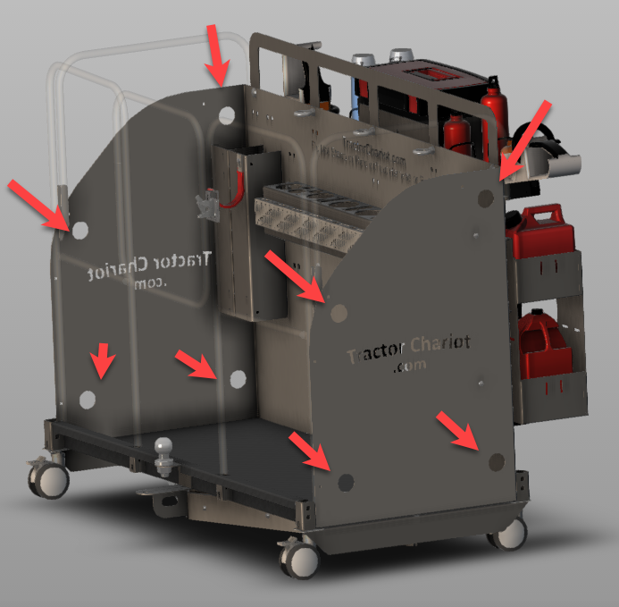
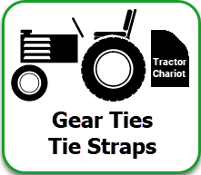
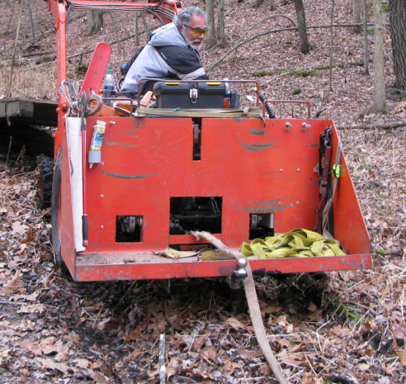
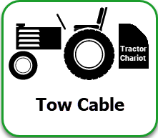
Gear Tie holes are used to secure equipment and
long handle tools
Tie Strap Holes are used for securing equipment,
and lifting the Tractor Chariot
A tow cable or tow strap is attached to the
Tractor Tongue though an opening in the
Chariot to Securely pull logs, vehicles and
other heavy objects
Tractor Chariot

Slide 14
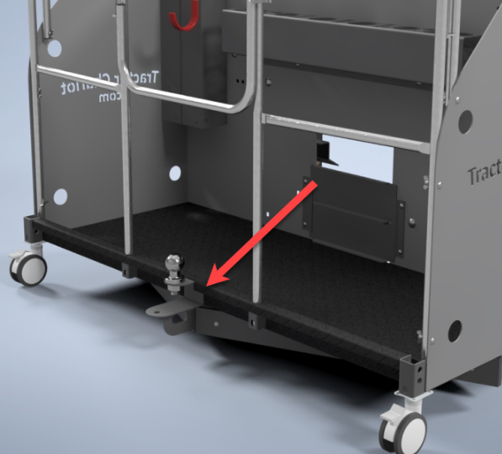

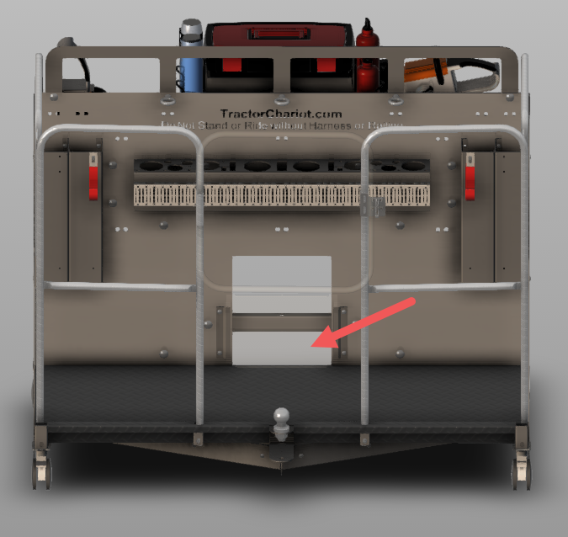
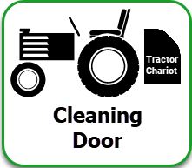
A Universal "Ball, Pin or Hook" hitch,
is used for pulling carts, trailers, sprayers,
spreaders and landscaping drags
A Sliding Door enables you to easily remove dirt
and debris from the Chariot
The opening enables water to drain out of the Chariot
2 Sliding Doors can be used to completely close
the opening, to prevent dirt, gravel and snow
from entering the Chariot
Tractor Chariot

Slide 15
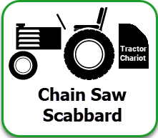
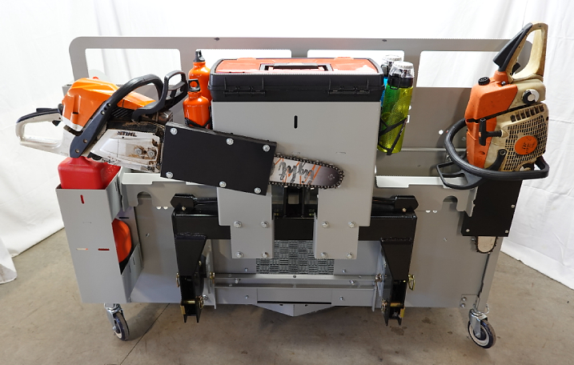
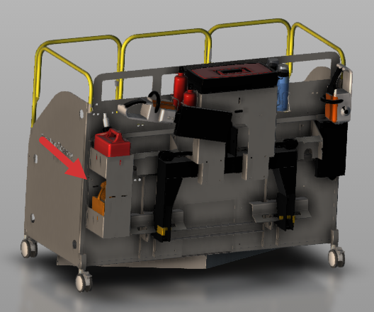
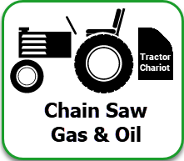
A Scabbard mounted on the Chariot holds up to
a 30" Chainsaw
The Scabbard makes it easy to remove and insert
the Chainsaw
The HDPE plastic Scabbard will not dull the Chainsaw teeth
A container mounted on the Chariot carries a
one gallon Gas can and Chainsaw Bar Oil for
easy access
Tractor Chariot

Slide 16

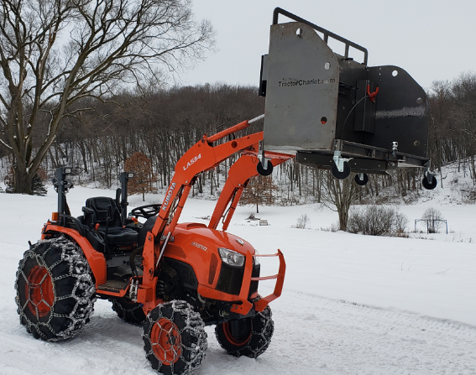

Quick Attach brackets transform the Chariot into
a Work Platform for Skid-steers and Tractors with
Quick Attach Loaders
The Safety Railing and Body Harness ensure safe operation of the Work Platform
More Tractor Chariot modules and accessories are being developed to add to the Chariots flexibility
and increase your productivity
Tractor Chariot

Slide 17
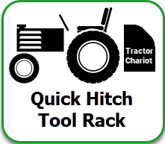
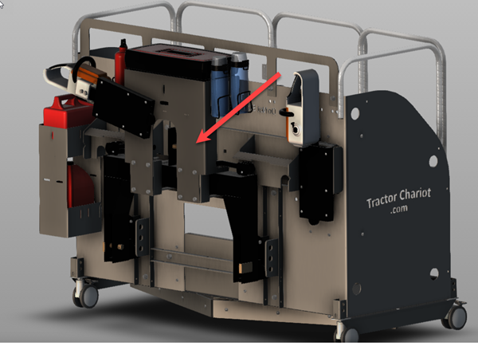
The Quick Hitch - Tool Rack bolts securely to any Quick Hitch and stays on the Tractor at all times
The Tool Rack features a
large removable Toolbox,
2 water bottles and
2 Fuel & Chain Oil bottles
The Tool Rack has a Chainsaw scabbard, for carrying a 16" Chainsaw
Quick Hitch - Tool Rack

Slide 18
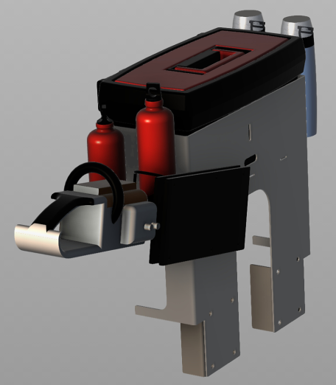
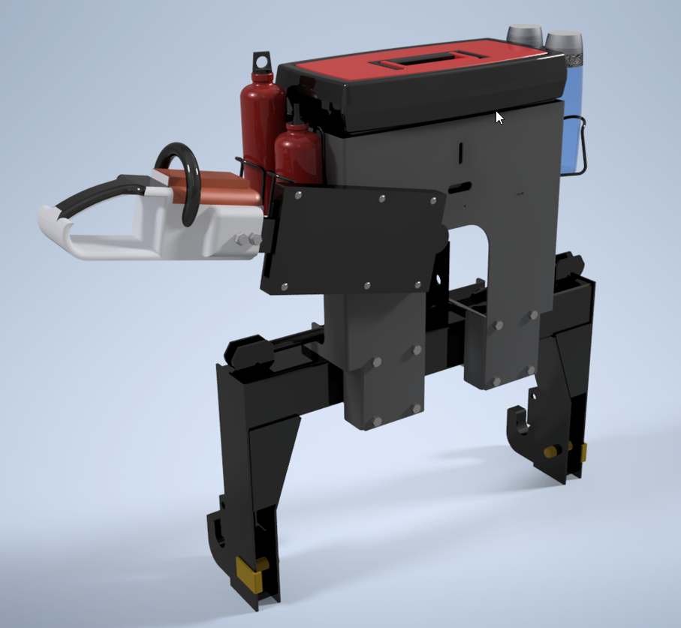
Quick Hitch Tool Rack
Tool Rack mounted on the Quick Hitch
Quick Hitch - Tool Rack

Slide 19


The Quick Attach Tool Holder bolts on any
3 Point Quick Attach and carries a Chain Saw,
a Large Toolbox and has Bottles Holders for
Water, Gas and Bar Oil
The Quick Attach and the Tool Holder is attached to the Tractor 3 Point Hitch, and stays with the tractor
at all times
Other Tractor Implements are easily attached to
the Tractor Quick Hitch with 2 simple levers
Quick Hitch - Tool Rack

Slide 20
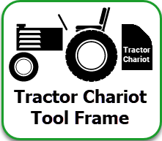
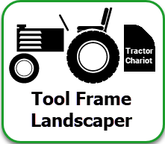
The Tractor Chariot Tool Frame is currently in development for future release
The Tool Frame is a multi-purpose attachment, that easily mounts to the Tractor Chariot
A variety of Time Saving Tools and Utilities can be mounted on the Tool Frame and easily changed
The Landscaper easily mounts on the Tool Frame
and grades the ground from rough to smooth,
while driving forward or backward
Tractor Chariot – Tool Frame

Slide 21

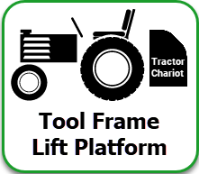
The Bank Mower mounts the Tool Frame to safely mow pond banks and ditches
The Bank Mower is mounting on a sliding
extension rail that can be extended out on
either side of the Tractor
The Lift Platform easily attaches to the Tool Frame and for carrying objects and equipment from one location to another
The Lift Platform lowers to the ground for easy loading and is raised with the Tractor Chariot
Tractor Chariot – Tool Frame

Slide 22


The Seeder/Spreader easily attaches to the Tool Frame.
The Seeder/Spreader preps the ground, spreads the seeds/fertilizer and packs the dirt, all in one pass
The Seeder/Spreader is ideal for seeding/fertilizing lawns and planting food plots
The Wire & Cable Spooler carries several barbed wire or cable spools
Fencing and stringing cable is easy with the Wire & Cable Spooler
Tractor Chariot – Tool Frame

Slide 23


Tractor Chariot – CAD Drawings

Slide 24



1. Chariot Body
2. Grab Handle
3. Bumper
4. Landscaping Drag
5. Universal Hitch
6. Tow Opening/Door
7. Tool Rack
8. Tool Tubes
9. Gas & Oil Holder
10. Chainsaw Scabbard
11. Tow Cable Opening
12. Skid steer Lift Brackets
13. Chainsaw Scabbard
Tractor Chariot – CAD Drawings
Download
CAD Drawings
Download
CAD Step Files

Slide 25


Top
Tractor Chariot & Tool Rack
View
Bottom
Landscaping Drag
View
Tractor Chariot – CAD Drawings

Slide 26


Left View
Tractor Chariot & Tool Rack
Right View
Tractor Chariot & Tool Rack
Tractor Chariot – CAD Drawings

Slide 27


Front Angle View
Tractor Chariot & Tool Rack
Rear Angle View
Tractor Chariot & Tool Rack
Tractor Chariot – CAD Drawings

Slide 28



1. Chain Saw Scabbard
2. Bottle Holders
3. Removable Tool Box
4. Bolt On Brackets
Tractor Chariot – Quick Hitch Tool Rack CAD Drawings

Slide 29

The Tractor Chariot Tool Frame is currently in development for future release
The Tool Frame is a multi-purpose attachment, that easily mounts to the Tractor Chariot
A variety of Time Saving Tools and Utilities can be mounted on the Tool Frame and easily changed
Tractor Chariot – Tool Frame CAD Drawings

Slide 30


Tractor Chariot – Costing

Slide 31

Tractor Chariot – Costing

Slide 32

Tractor Chariot – Costing

Slide 33

Tractor Chariot – Costing

Slide 34

Tractor Chariot – Costing

Slide 35

Tractor Chariot – Costing

Slide 36





Tractor Chariot – Trademarks

Slide 37
Product Trademark
Tractor Chariot
Quick Hitch Tool Rack
Tractor Chariot Tool Frame
Copyright Tag Lines
"Super Charge your Tractor"
"Every Tractor Needs a Chariot"
“The Essential Tractor Implement“
“Much more than a Carry All”
"Time Saving Tools"
"Time Saving Landscaping Tools"
"Time Saving Tractor Implements"
Web Domains
TractorChariot.com
PleasantValleyImplements.com
PleasantValleyProducts.com
Tractor Chariot – Trademarks

Slide 38

Tractor Chariot – Real World Innovative Design

Slide 39



Original Tractor Chariot
Original Tractor Chariot
Tractor Chariot – Real World Innovative Design

Slide 40

Early Generations
Tractor Chariot – Real World Innovative Design

Slide 41


Generation 2
Generation 3
Tractor Chariot – Real World Innovative Design

Slide 42


Generation 4
Generation 5
Tractor Chariot – Real World Innovative Design

Slide 43



Tractor Chariot – Real World Innovative Design

