Slide 1
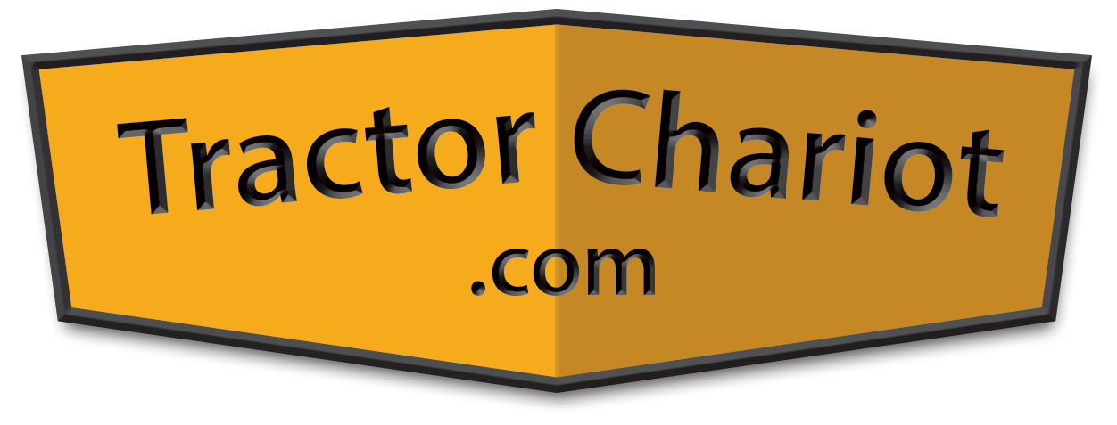
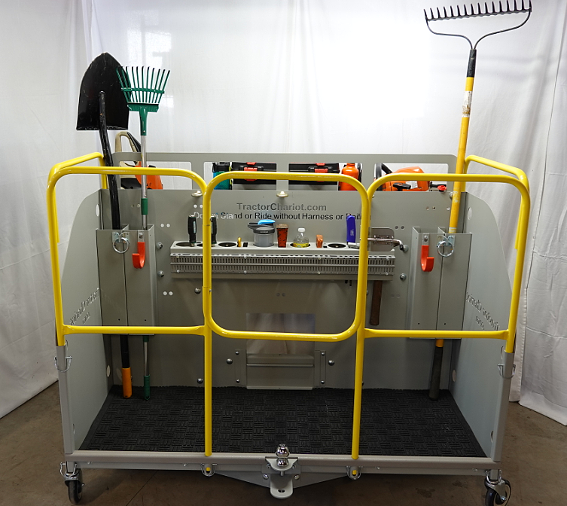
The Tractor Chariot is an Innovative and Indispensable Tractor Implement
This professional grade, multi-purpose Implement, easily attaches to any Tractor
The Chariot efficiently performs many maintenance, landscaping and wood cutting tasks
Property of Electronic Design Associates, LLC
Confidential and Proprietary Information - Not for Distribution

Slide 2
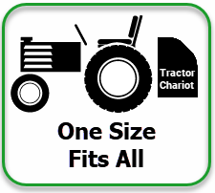
Property of Electronic Design Associates, LLC
Confidential and Proprietary Information - Not for Distribution

Slide 3
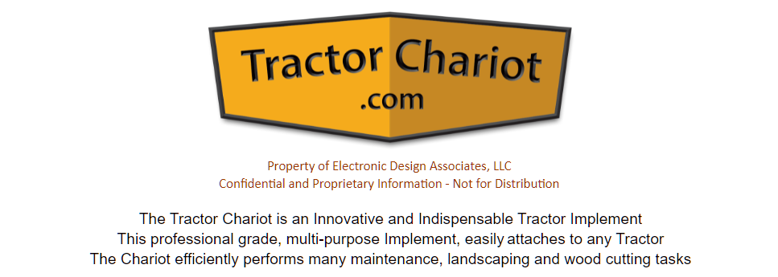
Tractor Chariot
Click to Play

